Slide 1

Image Processing vs Computer Vision
ITA0517-COMPUTER VISION
PRESENTED BY:
Yoga Madha A(192425058)
GUIDED BY:D
Dr Christy

Slide 2



Image Processing
Image processing focuses on manipulating
and improving images — transforming raw input
into a cleaner, enhanced output.
Image enhancement
Noise removal
Image restoration
Image filtering
Image transformation
Input Image
Processing
Improved Image

Slide 3
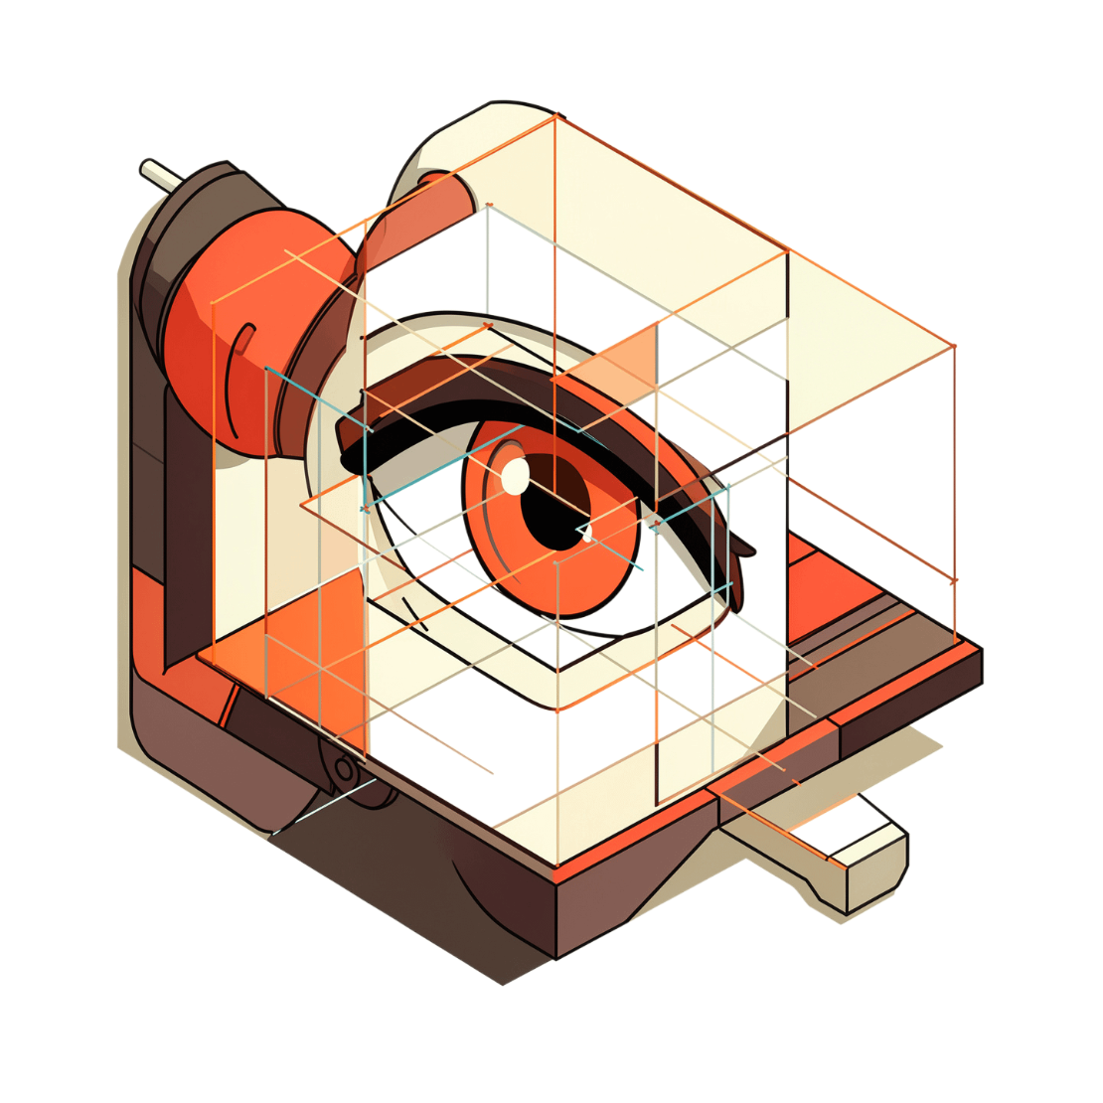
Computer Vision
Computer vision enables machines to understand and interpret visual information — going beyond pixels to extract meaning.
Image Classification: Identify what an image contains
Object Detection: Locate and label objects within a scene
Face Recognition: Identify individuals from facial features
Image Segmentation: Partition images into meaningful regions
Scene Understanding: Comprehend context and spatial relationships

Slide 4
Key Differences
Image Processing = Improving or transforming images
Computer Vision = Understanding and interpreting images
Aspect
Image Processing
Computer Vision
Main Goal
Manipulate & improve images
Understand & interpret images
Focus
Pixel-level operations
Semantic meaning & context
Output
Modified image
Decision, label, or insight
Techniques
Filtering, transforms, restoration
Deep learning, CNNs, feature extraction
Example Apps
Photo editing, medical scans
Self-driving cars, face unlock

Slide 5
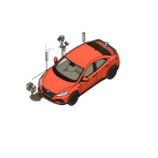

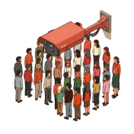

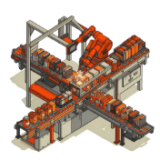
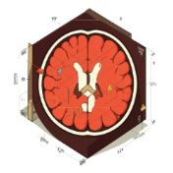
Real-World Applications
Computer Vision
Security & Surveillance
Autonomous Vehicles
Facial Recognition
Anomaly detection and crowd monitoring
Lane detection, pedestrian and obstacle recognition
Device unlock, airport security, attendance systems
Image Processing
OCR & Document Scanning
Industrial Quality Inspection
Medical Imaging
Digitizing text from printed or handwritten documents
Defect detection on manufacturing lines
MRI/CT scan enhancement and tumor detection

Slide 6
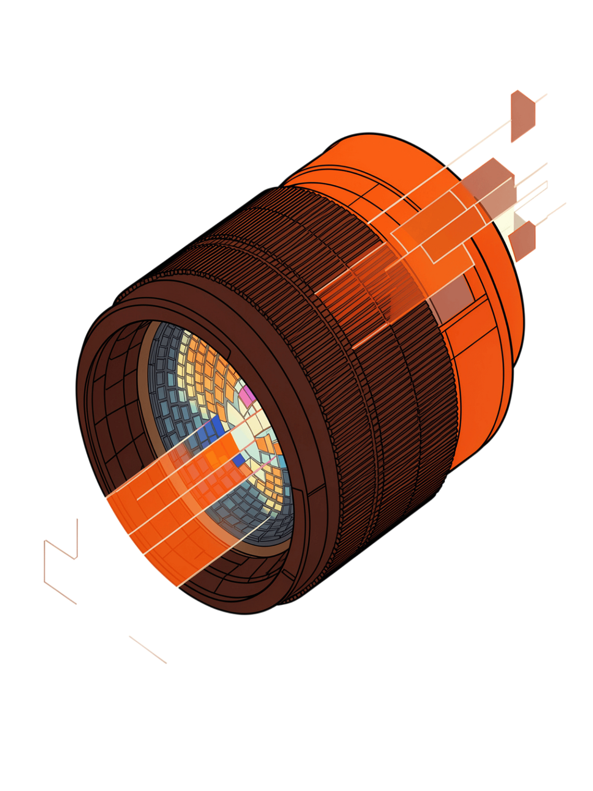
CONCLUSION
Image Processing focuses on improving and modifying images.
Computer Vision focuses on understanding and interpreting visual information.
Both technologies are important parts of Artificial Intelligence.
They are widely used in medical imaging, facial recognition, autonomous vehicles, security, and automation.
In simple terms: Image Processing makes images better, while Computer Vision helps machines understand them.

Slide 7
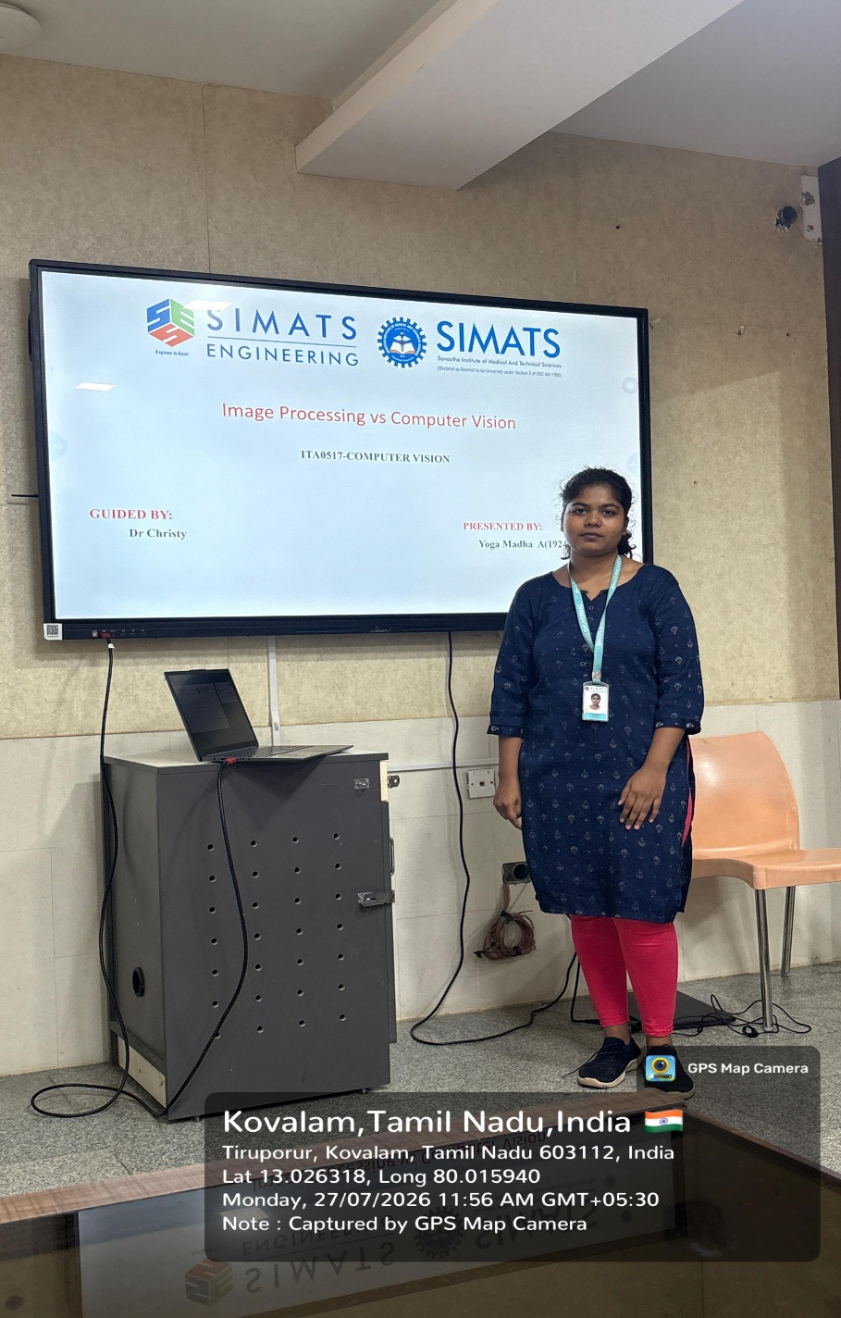

Slide 8
THANK YOU

